Slide 1
Nurture Autonomous Plant Care System
Sddec24-16
Chase O’Connell, Cameron Jones, Cayden Kelley, Blake Hardy,
Tejal Devshetwar, Holden Brown
Notes:
Cameron + All

Slide 2
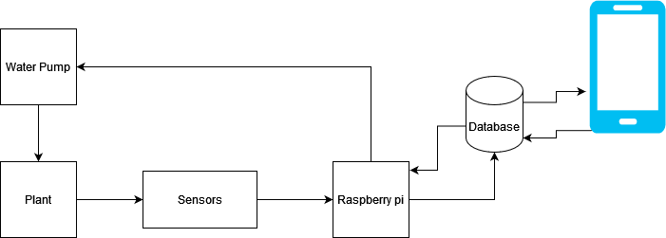
Project Overview
Create a device that automatically collects key soil nutrients.
Stores soil and user data on a backend
Mobile app for user interaction.
Websockets for real time communication.
Server has logic that sends commands to automatically water/fertilize plants when certain conditions are met.
Notes:
Cameron

Slide 3
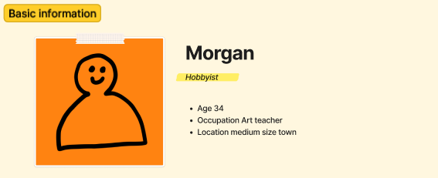
Target Demographic
Hobbyist gardeners
Middle end product
Trades absolute accuracy/precision for cost, still more precise than other products
Other possible demos: Farmers, Scientists

Slide 4
General Overview

Slide 5
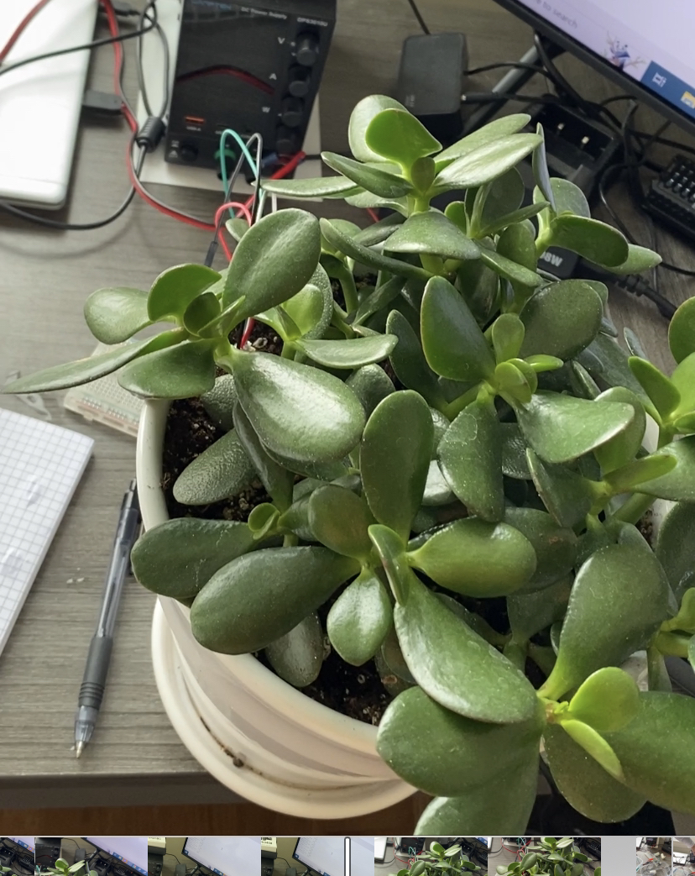
Requirements-Physical
Full Hardware Setup
Microcontroller
Sensors + Actuators
Water + Fertilizer Reservoirs
Plant Pot Compatibility
Clip to Side of Pot
Notes:
-Chase

Slide 6

Requirements-Power Requirements
Wall Powered
Meet all datasheet requirements
12V NPK sensor, 3.3V Pi Pico, 3-5V soil sensor, etc.
Low Power
Sustainability
Notes:
-Chase

Slide 7
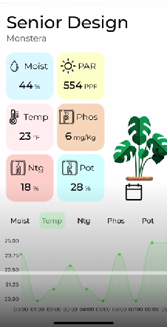
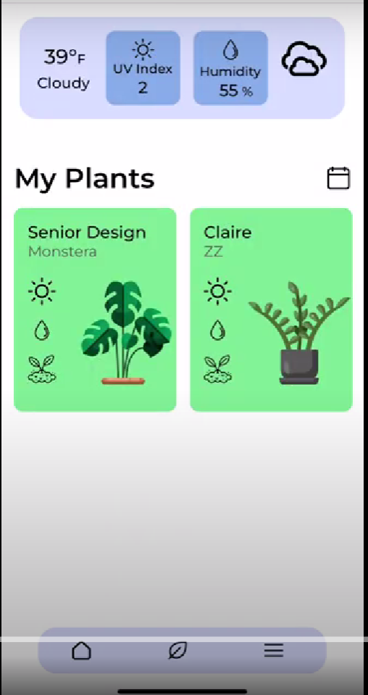
Requirements-UI
User friendly graphical representations of sensor data.
Ability to view past sensor data.
User and plant creation.
Current Local weather.
Notes:
-Tejal

Slide 8
Requirements-UX
Sensor readings should be updated once per hour.
User friendly design with intuitive functionality. Limited menuing
Efficient design enabling low load times.
Notes:
-Tejal

Slide 9
Constraints
Size:
1+ gallon(s) water reservoir for multiple days of watering.
12+ Inch Pot Diameter Compatibility
Power:
The device should be able to run without a charge for at least three days.
Max load shall not exceed 3 Watts
Max idle load shall not exceed 0.5 Watts
Cost:
The total material cost of the device should not exceed $300.
Notes:
-Tejal

Slide 10

Engineering Standards
IEEE 802.11ac WiFi Standard: The most
common wifi standard today.
IEEE 1451: Standard for smart transducer interface for sensors and actuators.
IP55 rating for dust and water resistance on device enclosure.
OWASP: Apply to open web applications principals to protect against common vulnerabilities.
Notes:
Cameron

Slide 11
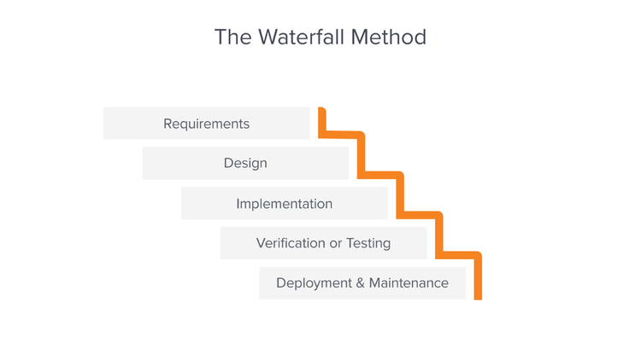
Development style
Waterfall
Our main software and hardware components can be developed in parallel
Integrate major components once completed
Agile or other methods would have likely only resulted in additional overhead with no significant benefit
Notes:
Cameron

Slide 12
Design Choices
Notes:
Blake

Slide 13
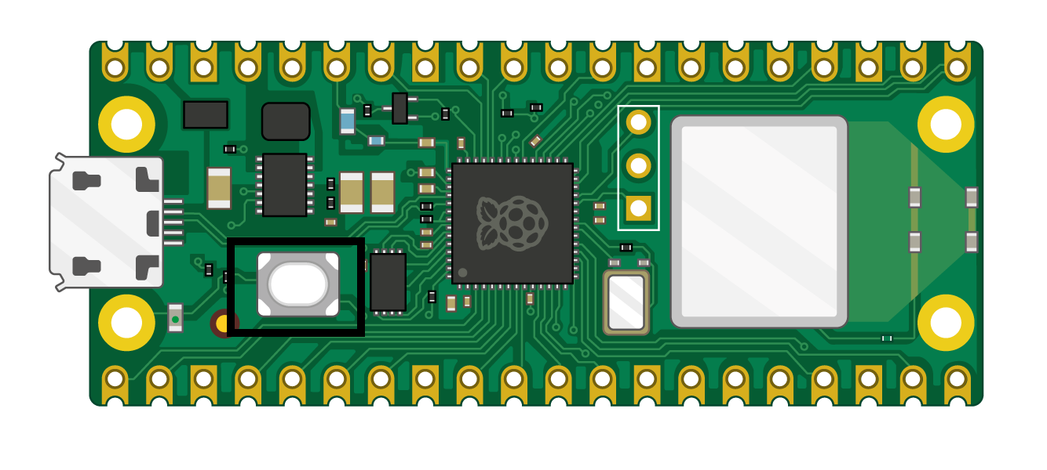
Microcontroller
Pi Pico W
Small size
Low cost
Low power/heat
Wireless communication
Good library support/popular
Drawbacks and relevant limitations
No native modbus support
Limited built in power options
Other considered controllers
Pi4/zero
Arduino mkr1010
No single option offered every desired feature.
Notes:
blake

Slide 14
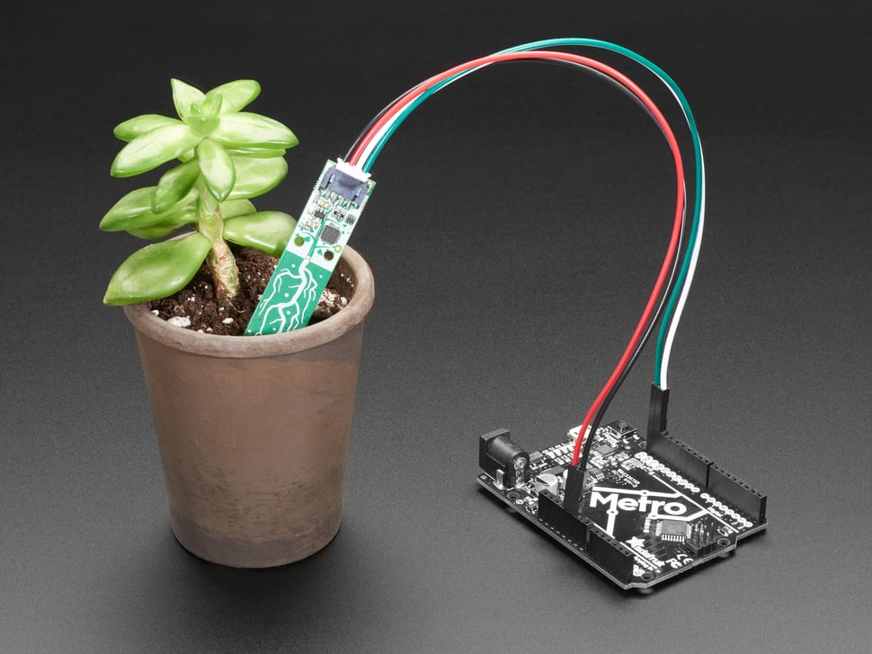
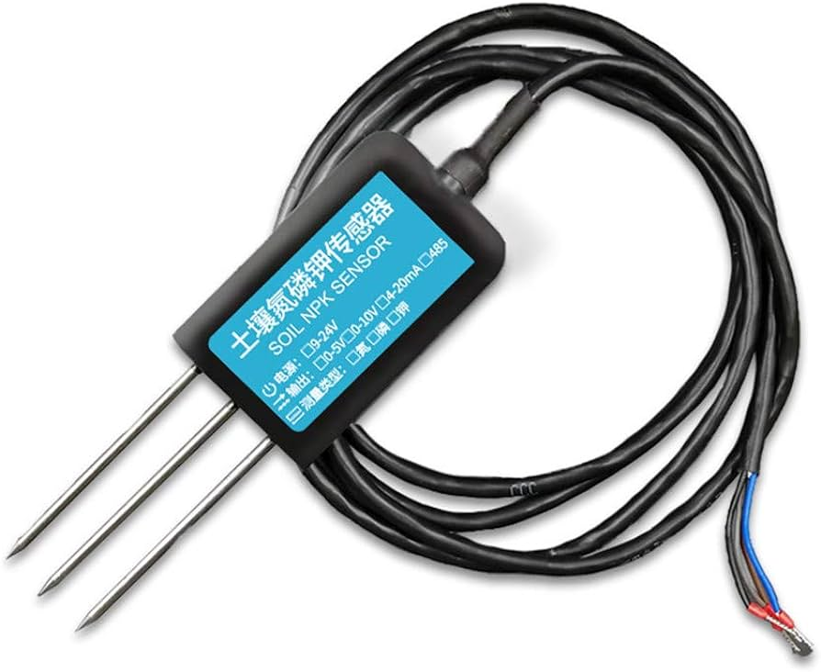
Sensors
Moisture and Temperature
Simple test bed
Easy to use and provides useful data
I2C communication
NPK sensor
More challenging to utilize
Limited options available
Rs485
Notes:
blake

Slide 15
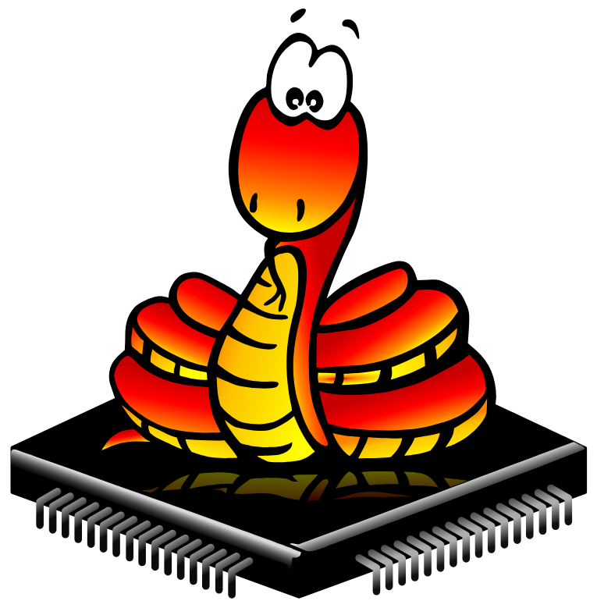


Software / languages
MicroPython
Easy integration with the pi zero
Well supported by free libraries
MongoDB
Easy environment setup and offers a lot of flexibility
Node
Communication between MongoDB and users.
React Native
Live & hot reloading feature allows faster UI development
JavaScript across frontend and backend
Cross platform app development possible for iOS and Android
Notes:
½ Blake + Holden

Slide 16
Current Features

Slide 17
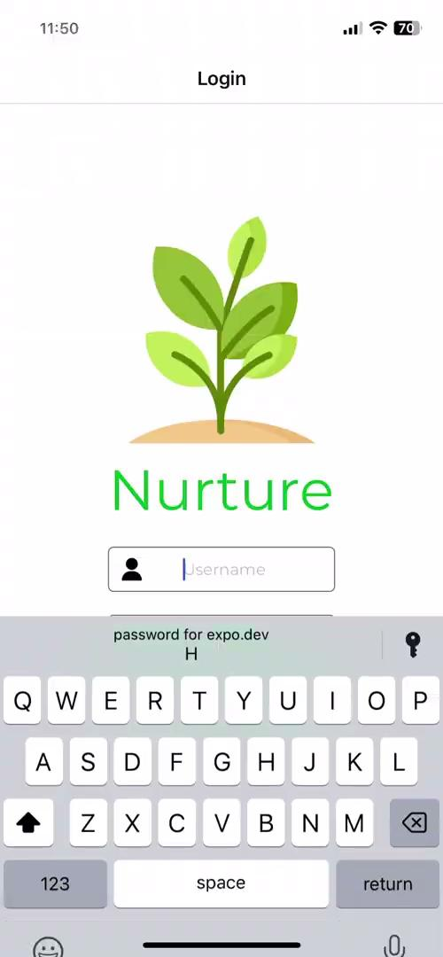
Frontend Demo
Notes:
-Holden

Slide 18
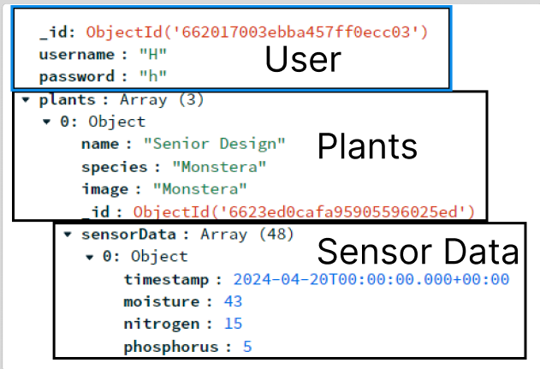
Backend MongoDB Atlas cloud with Node
Nested schema setup for easy management of users
User has a list of plants
Each plant has a list of sensor data
After login user is stored within the app
MongoDB and Node are a match made in heaven
JavaScript native JSON handling
Asynchronous programming model
Notes:
-Holden

Slide 19
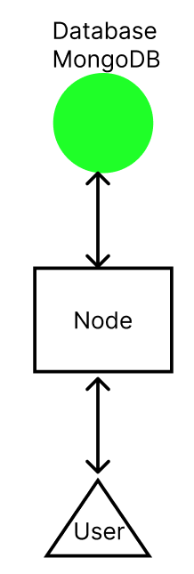
Notes:
-Holden

Slide 20
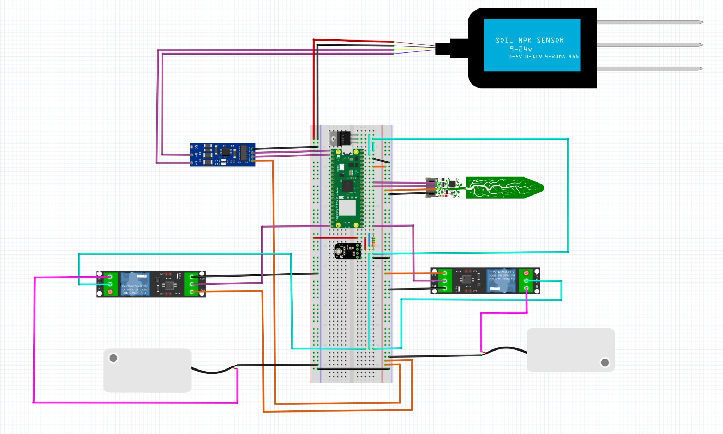
Hardware
Ground
12 V Power
3.3 V Power
Nitrogen, Phosphorus, and Potassium Sensor
Pico Power Out
Switched 3.3V
Communication
RS485 to UART converter
Soil Moisture & Temp. Sensor
Relays
Water Pumps
Notes:
Cover pump system as well here.
-Cayden

Slide 21
Hardware
(***Put picture of actual hardware setup so far here, including relays, pump, NPK, RS485 converter, etc. Maybe the water reservoir too just to illustrate the idea***)
-***Might also want to include a screenshot of the sample data being read into the Pi Pico***
Notes:
-Cayden

Slide 22
Future Plans

Slide 23

Hardware
Enclosure
Justification: IPX5 Water Resistance
Custom PCB
Justification: Form Factor
Power Requirements
Barrel Jack + Wall Outlet Converter
Rechargeable Battery
Buck Converter 12V to 3.3V
Signal Requirements
Trace Routing
Notes:
-Chase

Slide 24
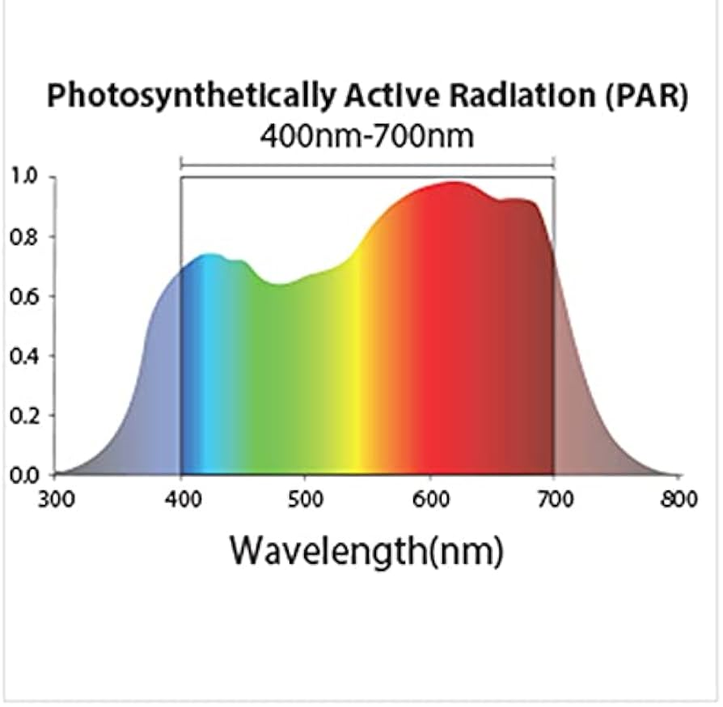
Additional Sensors
Communication Protocol
RS485
I2C
UART
Sensor Types
Ambient Light (PAR)
Ambient Humidity
Soil pH Level
Notes:
-Chase

Slide 25
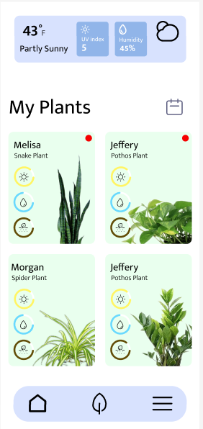
Software features
Notifications
Communication between two users to share individual plant information.
Notifications & user set reminders.
Graph full screen capabilities and detailed view.
Quick account creation with Google Gmail.
Websocket communication between the app and Raspberry Pi.
For real time communication.
User control of dispensers.
Notes:
-Tejal

Slide 26
Questions
Notes:
-Tejal

